Slide 1
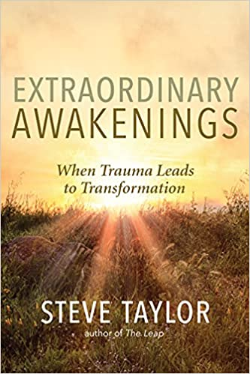
Transformation through Turmoil: When Spiritual Awakening is Sudden and Dramatic Steve Taylor PhD www.stevenmtaylor.com

Slide 2
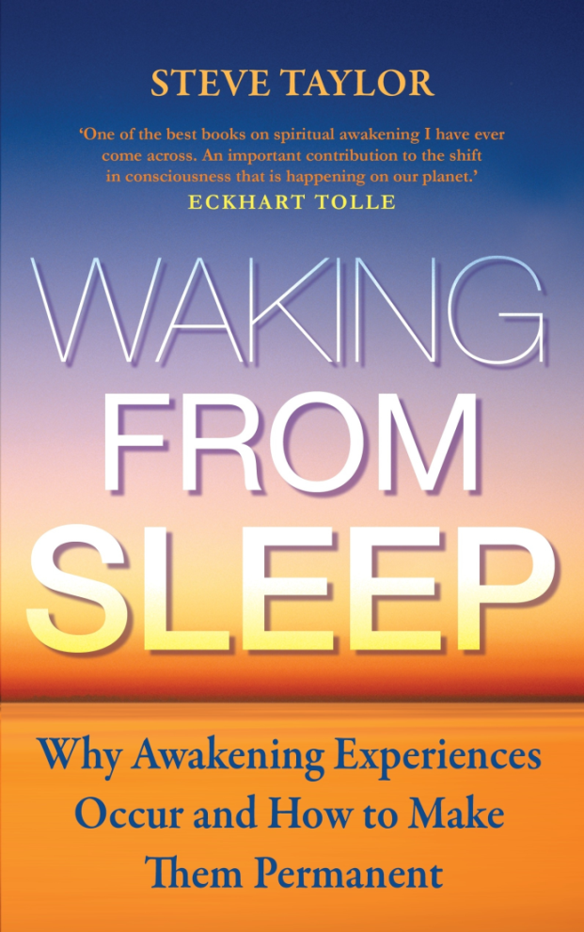
Awakening Experiences
“Have you ever had an awakening experience, in which your awareness of reality has intensified and expanded?
This could be an experience in which your surroundings have become brighter and more real, and you’ve become struck by the unusual beauty and vividness of things. Perhaps you’ve felt a sense of connection to them and a deep sense of well-being inside you. Or perhaps you have felt a sense of harmony and meaning pervade the world, a sense that all things are one, and that you are part of this one-ness. The experience may have left you with a sense that life is more meaningful.”

Slide 3
Activities and Situations
Associated with Awakening Experiences
(Taylor & Egeto-Szabo, 2017)
Of 91 awakening experiences, the most common were:
Psychological turmoil (e.g. stress, depression, loss, bereavement) 37
Contact with Nature 23
Spiritual practice (e.g. meditation, prayer, yoga) 21
Spiritual literature (or audio/video) 15
Love/Sex 5
Watching or listening to an arts performance 3

Slide 4
“I saw reality as simply this perfect one-ness. I felt suddenly removed from everything that was personal. Everything seemed just right….All my ‘problems’ and my suffering suddenly seemed meaningless, ridiculous, simply a misunderstanding of my true nature and everything around me. There was a feeling of acceptance and oneness. It was a moment of enlightenment. The euphoria and inexplicable rush of ‘knowledge and understanding’ following this episode lasted for days.”

Slide 5
Have you ever had a bad experience – involving stress, upset, suffering and turmoil – which you feel that, in the end, made you a stronger and deeper person?
3

Slide 6
Post-Traumatic Growth Trauma may have positive effects which transcend simple adjustment and coping. Post-traumatic growth (PTG) has five main areas:
Personal strength
Relating to others
Appreciation for life
New possibilities
Spiritual change

Slide 7
Transformation through Turmoil
Intense psychological turmoil or trauma (such as serious illness, bereavement, depression, disability, addiction, loss) may give rise to a dramatic transformation into a higher-functioning state, equivalent to permanent spiritual awakening.
It is not uncommon amongst prisoners and soldiers.
It addicts, it may manifest itself in ’addiction release’ – a sudden freedom from craving.
It may also manifest itself in the sudden disappearance of physical ailments, and also of the negative effects of trauma.

Slide 8
A New Identity
“It’s like there are two people – there’s a before and after.”
“I’ve moved up to another level of awareness which I know is going to stay with me. It’s like the transformation a caterpillar goes through during the chrysalis stage before emerging as a butterfly.’”

Slide 9
Irene Murray
‘It was the first time I’d seen death as a reality, and realised that life is just temporary. The following day I woke up and thought “I’m just so lucky to be alive, the fact that I’m still here.’ The air was so clean and fresh and everything I looked at seemed so vibrant and vivid. The trees were so green and everything was so alive. I became aware of this energy radiating from the trees. I had a tremendous feeling of connectedness.”
‘That feeling was really intense for the first few weeks, and it’s remained ever since. It just blew me away, it really did. I used to just sit and think, “This is amazing, that things could just fall into place so quickly.”’

Slide 10
Gill Hicks: Survivor of the 7/7 London Bombings
“From the moment I was given the option of choosing life, vowed that I would never take anything – all that I have – for granted again.
I no longer look for complications and they don’t come and find me. It’s amazing! All the rubbish of life has just slid away. I feel liberated…
My path is being laid and being lit every day. I can see so clearly where I am meant to be going…it’s like an airport runway, where the bright lights along the strip guide the planes in…

Slide 11
Suicide and Spiritual Awakening – Eve’s Story
After 29 years of alcoholism, Eve was, “a wreck, an empty shell. I’d walk a few steps and then have to stop and sit down or lie down… I had nothing to live for, nothing to give and I thought, ‘I can’t do this anymore.’
“I kept picking it up and putting it down. It wasn’t me that was putting it down…I looked at myself, and it was a surreal experience. I didn’t connect with my reflection. I felt like a different person.”
“My whole psyche changed completely. I have no trauma, in spite of all the terrible things I went through. It was like being catapulted from one world into the next.”

Slide 12
Challenges
Transformation through turmoil can be smooth, but often brings challenges. Sometimes there are psychological disturbances, physical issues (e.g. pain, sleeplessness, uncontrollable energy), difficulties with social interaction and working
These may continue for a long time (sometimes several years) but always settle down eventually, leading to integration
These disturbances can be managed to a large degree, through the support of others, through an understand therapist, diet, lifestyle, contact with nature, meditative exercises etc.

Slide 13
The Importance of a Conceptual Framework
Most ”shifters” didn’t have background in spirituality and so didn’t understand what had happened to them.
Their new sense of well-being and connection was overlaid with confusion. Their friends and family sometimes encouraged this by suggesting that they had “gone mad” or that there was “something wrong” with them.
Shifters with a background in spirituality didn’t suffer as much from confusion.
All shifters did eventually make sense of their transformation. They gravitated towards spiritual books or groups. Then there was a sense of “Ah, so I’m no crazy after all!”

Slide 14
Explaining Transformation Through Turmoil
Ego-Dissolution, either through intense stress causing a sudden breakdown
Attachments are the ‘building blocks’ of the ego, so when attachments dissolve, the ego itself dissolves.
The normal self gives way, and again there is an open space of being for a latent higher self to emerge and fill.

Slide 15
Why doesn’t everyone experience Transformation through Turmoil?
Openness to Experience – soft ego-boundaries
‘Readiness’
Acknowledgement and Acceptance – many of the ‘shifters’ could identity a point where they accepted their situation. This was often the moment when transformation took place.

Slide 16
Three Stages of Harnessing
the Transformational Potential of Adversity
1. Acknowledgement. Face the reality of your predicament Don’t mentally push it away – acknowledge it. Also acknowledge the negative feelings the predicament creates.
2. Exploration. Go inside yourself; explore your subjective experiences. Be aware of your negative feelings and the thoughts which accompany them. Then be aware of yourself as the observer of your feelings of thoughts, and the space between you and them.
3: Acceptance. Make a conscious effort to let go of your resistance. Instead, embrace and accept your predicament. Open yourself up of it, feeling a sense of release.

Slide 17
The Alchemy of Acceptance Exercise

Slide 18
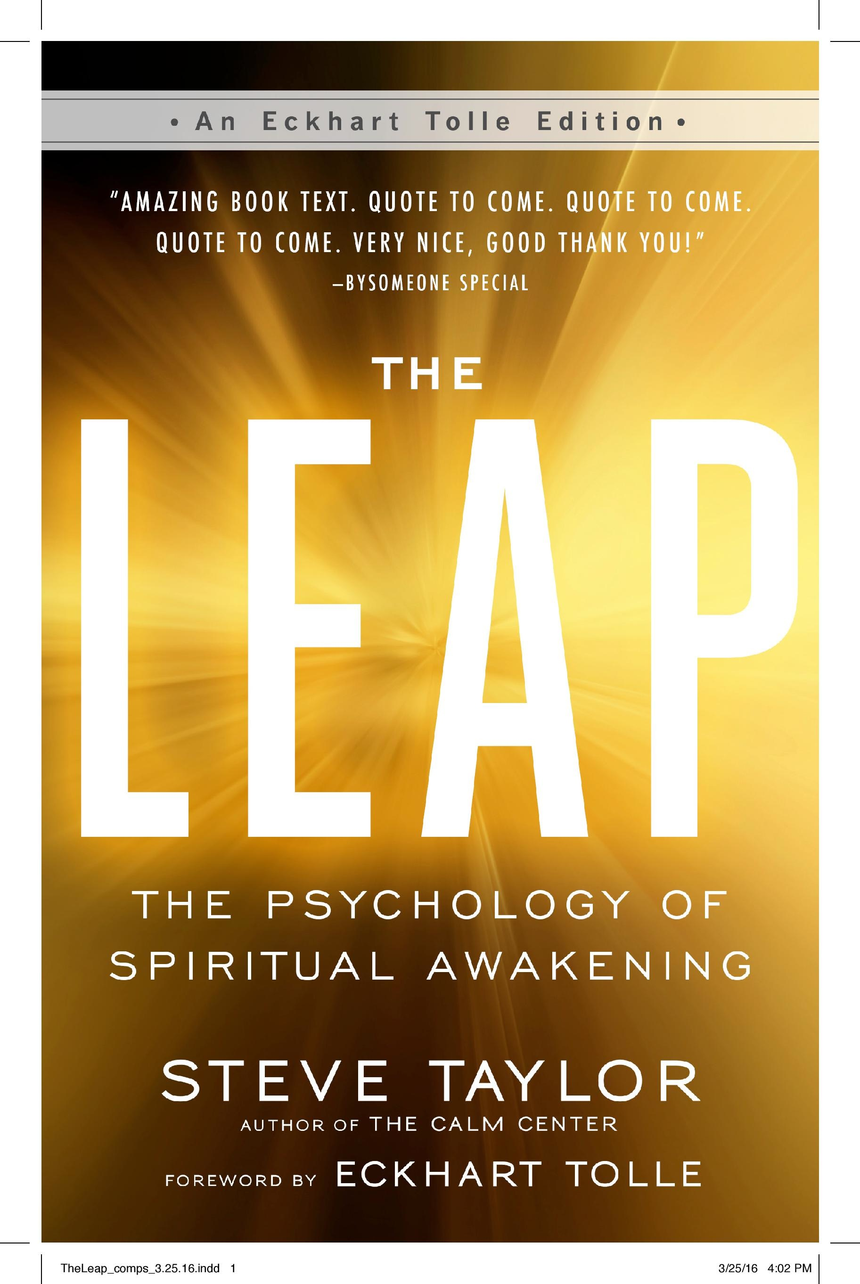
Further Information:
www.stevenmtaylor.com

