Slide 1
A Service Evaluation of the UK Spiritual Crisis Network (SCN)
Mike Rush
PhD Student at Canterbury Christ Church University,
supported by the Professional Development Foundation and the Alef Trust.
Supervisors:
Prof. Les Lancaster, Dr David Lukoff, & Prof. David Lane (Chair).

Slide 2
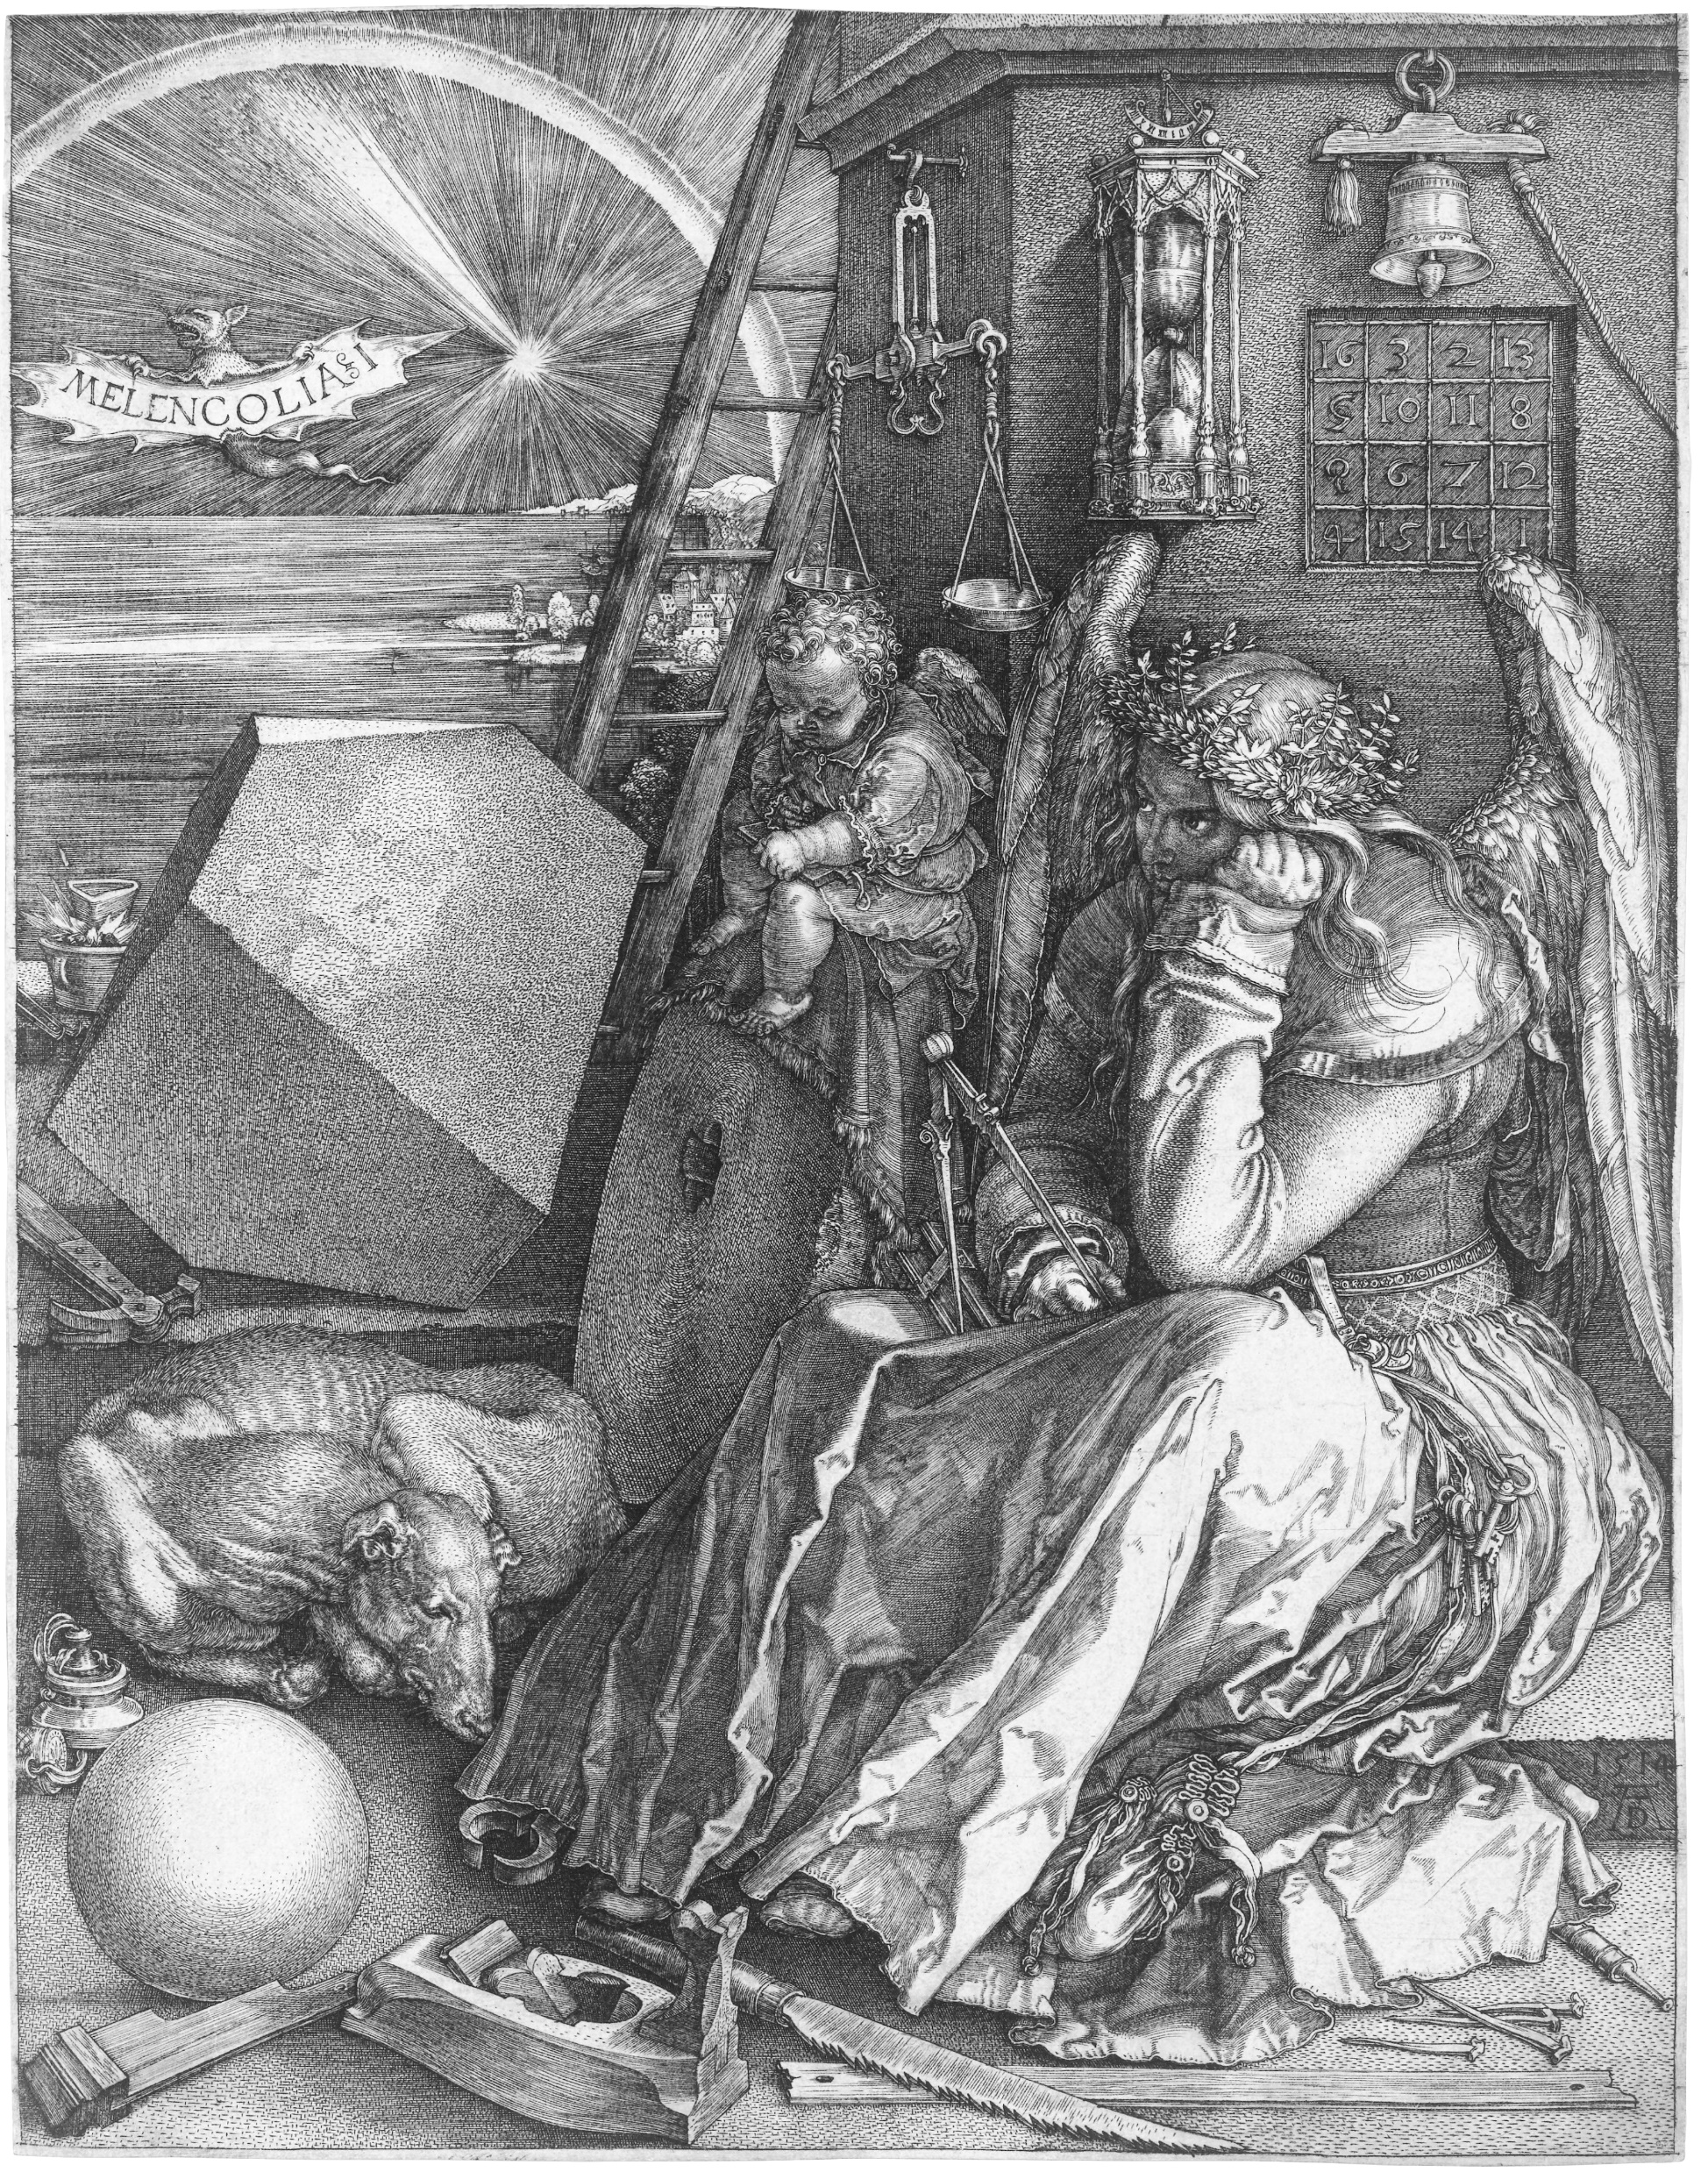
Overview
What is Spiritual Crisis/emergency?
What does the Spiritual Crisis Network (SCN) do?
Research Methodology
Summary of Research Results

Slide 3
Part One: What is spiritual crisis/emergency?

Slide 4
What is a Spiritual Crisis?
Any spiritual or anomalous experience that causes concern or distress for the person who experiences it, or for those around them.

Slide 5
Composite Definition
These experiences are generally understood to be spontaneous and involuntary natural processes, where someone may be overwhelmed by spiritual energies and experience ASCs alongside challenging or turbulent emotions, perceptions, sensations, and thoughts, often with a spiritual or mythical theme.
These experiences can be difficult to integrate, entailing changes in beliefs and behaviours that usually take the individual beyond their personal ego identity into a transpersonal or expanded sense of self. The process is one of psychospiritual development or transformation that can result in greater wisdom, compassion, creativity, inner peace, and a deeper connection with people, nature, or the cosmos.

Slide 6
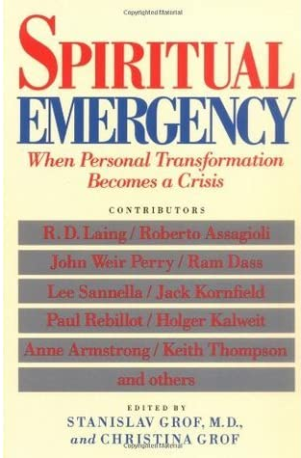
Ten Varieties of Spiritual Emergency
i) Episodes of Unitive Consciousness (Peak Experiences)
ii) Kundalini Awakening
iii) Near-Death Experiences
iv) Shamanic Crisis or Journey
v) Psychological Renewal through Return to the Centre or Activation of the Central Archetype
vi) Awakening of Extrasensory Perception or Psychic Opening
vii) Emergence of Past-Life Memories or a Karmic Pattern
viii) Communication with Spirit Guides and Channelling
ix) Experiences of Close Encounters with UFOs
x) Possession States

Slide 7
Part Two: What does the Spiritual Crisis Network (SCN) do?

Slide 8
The Spiritual Crisis Network (SCN)
Founded in 2004, limited company in 2008, online in 2011.
Staffed by volunteers.
Experiencers, therapists, trainee therapists.
Non-profit organization.
Agnostic/open-minded.
Not an anti-psychiatry organization.

Slide 9
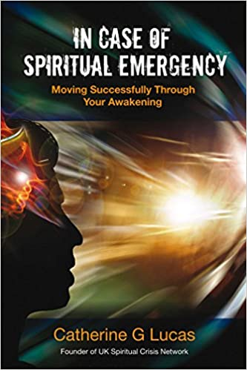
The Spiritual Crisis Network
The SCN provides a number of services:
Support via Email
Website
Peer-support Groups
Training & Awareness
Academic Conferences
Online Discussion Forum

Slide 10
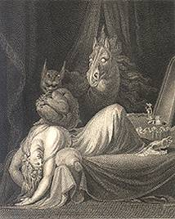
SCN Audit
In 2020 the SCN was contacted by 258 people.
128 of these were asking for support for, or advice about, their own experiences.
27 were asking on behalf of someone else.
In 2020 the SCN received 58 thank you messages and 0 complaints.

Slide 11
SCN Audit

Slide 12
Some Examples
“I have recently had what I would call a spiritual emergence or crisis. My doctor has not been much help so I am looking for help and advice as to what I should do next and indeed to know what actually happened to me.”
“I am currently going through a period of identity dismantling, spiritual crisis, deep personal transformation. I need support with this, I am finding this period quite challenging.”
“I have a friend who is having a difficult time. She is not in crisis but I am concerned that she may be soon. I had a crisis myself about 8 years ago and found the support of a local group invaluable. I am trying to organise some support in case my friend has a crisis.”

Slide 13
Part Three: Research Methodology

Slide 14
Literature Review
What is The Empirical Evidence-base for Interventions for Spiritual Crisis?
Alternative Approaches
Mosher, (1999); Mosher & Bola, (2004); Mosher, Vallone & Menn, (1995).
Positive Appraisals
Brett et al. (2007, 2010 & 2014); Hartley & Daniels (2008); Heriot-Maitland et al. (2012).
Frameworks & Narratives
Brett (2010); Fischler, (2019); Hartley & Daniels (2008); Kaselionyte & Gumley (2017, 2019); Lukoff & Everest, (1985).
Practices, Behaviours, & Attitudes
Benning et al (2018); Bonnie Hood (1986); Brooke (2019).
Complementary Strategies
Sedláková and Řiháček (2019).

Slide 15
Study Objective & Research Questions
Objective
To evaluate the Spiritual Crisis Network by gathering experiencer feedback on the services provided by the SCN.
Question #1
Did people find contacting the SCN helpful or unhelpful?
Question #2
Why was contacting the SCN helpful or unhelpful?
Question #3
How did the SCN compare to mental health organisations?

Slide 16
Stakeholder Consultation & Information
CCCU & PDF
The Researcher
Participants
SCN Volunteers
SCN Directors
Other Researchers
Therapists
Support Organisations
Study Design
Data Protection & GDPR
Participants Database
Survey Specification
Peer Feedback
Survey Pilot
Data Collection
Initial Audit of Emails
Participant Invitations
Participant Queries
Online Survey
Compilation of Emails
Data Analysis
Attitude Ratings
Thematic Analysis (Deductive)
Thematic Analysis (Inductive)

Slide 17
Ethics
Data Protection Policy & Consent.
Stakeholders Consulted & Informed.
I did not send survey invitations to people who had contacted the SCN in the last twelve months, as they may still be vulnerable due to their recent crisis.
I gave survey respondents the option to either remain anonymous or be named in the research report.
All participants provided consent and were also provided with a participant information sheet that signposted them to additional support resources.

Slide 18
Part Four: Summary of my Research Results

Slide 19
Survey Results: Demographics
1605 people invited.
107 (6.7%) responded.
61% female, 36% male, and 3% preferred not to say.
39% no-religion, 28% Christian, 24% other.
48% degree, 33% postgraduate qualification.
69% White British.
Age when crisis began: 24% 25-34 and 30% 35-40 years old.

Slide 20
Survey Results: Experiences
74% - some or great distress for themselves.
72% - some or great distress for those around them.
75% - feel they have integrated their spiritual crisis.
75% - their spiritual crisis was a positive, transformational experience for them.

Slide 22
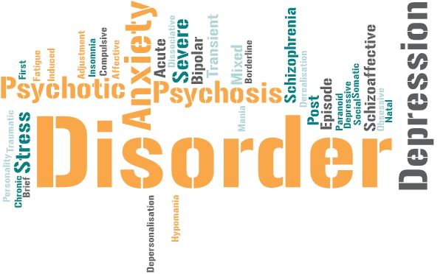
Survey Results: Experiences
37% of survey participants reported that they had received a mental health diagnosis during their crisis.
Some may have preferred not to reveal their diagnosis, whilst others may not have contacted mental health services. Therefore, it should not be assumed that a spiritual crisis necessarily indicates a mental health issue.

Slide 23
Survey Results: Q1. Was the SCN Helpful?
64% contacting the SCN either Moderately or Very Helpful.
63% Satisfied or Very Satisfied with the support they received from the SCN.
76% Likely or Very Likely to recommend the SCN to someone else.
51% interested in volunteering with the SCN.
10% rated the SCN as Moderately or Very Unhelpful
13% indicated that they were Dissatisfied or Very Dissatisfied.

Slide 24
Survey Results: Q2 What was Helpful?
Four Main Themes:
Benefits of Contacting the SCN.
A New Perspective.
How People Felt.
Qualities of the SCN Volunteers.

Slide 25
Emergent Themes: How People Felt
“It felt extremely personal, empathetic and helped me feel less alone, and more grounded.”
“It gave me hope that there were others out there who saw mental illness differently to mental health services.”
“I felt understood. Someone knew it was going to be ok, huge relief.”
“Many thanks for taking the time to contact me; it has helped me to not feel as alone.”
“To feel supported and taken seriously was paramount importance to me.”
“Just thing that somewhere are people who try to understand gave me undescridable feeling of comfort in this dark time.”
“All the best to you and the team and please keep up the amazing work for people who are lost and alone.”

Slide 26
Emergent Themes: SCN Volunteers
“The relief of being around a group of understanding, empathic people was immense.”
“Any topic around spiritual crisis and mental health was welcomed. Personal experiences were welcomed. The wisdom of the members was welcomed. It was a very welcoming environment.”
“They took my confused thoughts without judgement and gave them back to me in a way that made more sense.”
“Thank you so much for your reply- it was lovely to receive such compassion and support from a stranger. I'm glad to say I'm coping far, far better now!”
“The only place I feel that had any close understanding of who and what, why was happening to me was the person that replied to my cry for help … this person I found at spiritual crisis network... the only place that warmed my heart with understanding was the spiritual crisis network.”
“I was surprised someone had taken the time to really listen to me and provide some ‘holding’, demonstrate they heard and understood my pain and anguish, validated my feelings and even suggest some things which I could call on to help me at the time.”

Slide 27
Survey Results: Q4. SCN & MH Services
70% of respondents contacted a mainstream mental health service during their crisis.
47% found that the mental health service was helpful.
18% found their diagnosis helpful.
80% contacting the SCN was Slightly or Much More Helpful than contacting mental health services.
40% that the mental health service was unhelpful.
49% found their diagnosis unhelpful.
11% contacting the SCN was Slightly or Much Less Helpful.

Slide 28
Summary & Conclusions
Not Therapy but Therapeutic in Effect.
The SCN was rated as helpful, to a greater or lesser degree, by the majority of participants.
However, this approach is not appropriate for everyone.
Not What We Do but How We Do It.
The Importance of volunteer qualities, attitudes, and behaviours.
Practices, attitudes & behaviours can be helpful. However, what appears to be most helpful is how people respond.
Complementary not Alternative
A complementary approach to mainstream mental health services.

Slide 29
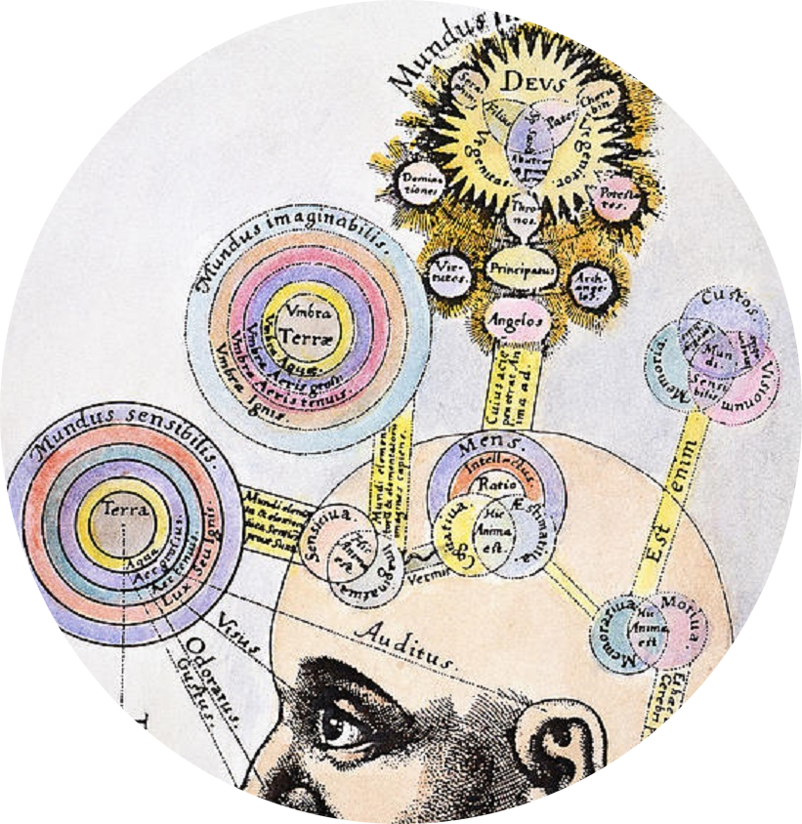
Contact and Further Info:
Spiritual Crisis Network
info@spiritualcrisisnetwork.uk
www.spiritualcrisisnetwork.uk
Mike Rush
mike@talkaboutspiritualcrisis.uk
www.talkaboutspiritualcrisis.uk

