Slide 1
Evidence-Based Practices for Integrating Spiritual Emergencies
Marie Grace Brook, PhD, LCSW, ACMHP,
Cert. Spiritual Direction, ACSGC
Santa Cruz, California, USA
MarieGraceBrook.com
MarieGraceBrookPhD@gmail.com
Spiritual Crisis: Supporting Positive Transformation
Spiritual Crisis Network UK
April 2, 2022

Slide 2
1980 ~ What motivated me?

Slide 3
Sept 1980-Aug 1981 How did I try to integrate my STE?

Slide 4
Sept 1981 – How long did integration take?

Slide 5
April 2022 –
becoming a Principal Investigator for STE research
Finishing my Book on STEs
becoming a graceful grandmother
becoming a less high-maintenance wife

Slide 6
Brook, M. G. (2021). Struggles reported integrating intense spiritual experiences: Results from a survey using the Integration of Spiritually Transformative Experiences Inventory. Psychology of Religion and Spirituality, 13(4), 464–481. https://doi.org/10.1037/rel0000258
Research Question
What assists an individual to integrate a spiritually transformative experience (STE)?

Slide 7
Integration of Spiritually Transformative Experiences 84- Item Inventory (ISTEI) Survey Research Study

Slide 8
Created Inventory
Practices, habits and behaviors
that assist in integrating STEs.
Yvonne Kason
David Lukoff
Ryan Rominger
Yolaine Stout

Slide 9
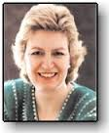
Yvonne Kason, MD
Author of book
Farther shores:
Exploring how near-death, kundalini and mystical experiences can transform ordinary lives, 1994
– 35 survival techniques
for STE integration
Kason, Y. (2008). Farther shores: Exploring how near-death, kundalini and mystical experiences can transform ordinary lives. Bloomington, IN: Author’s Choice Press of iUniverse. [first published 1994]

Slide 10
David Lukoff, PhD
Introduced new category to the DSM-IV called
“Religious or Spiritual Problem”
– 9 therapeutic interventions
for STE integration
Lukoff, D., Lu, F. & Yang, C. P. (2011). DSM-IV Religious and spiritual problems. In Peteet, J.
Lu, F. & Narrow, W. (Eds.) Religious and Spiritual Issues in Psychiatric Diagnosis: A Research Agenda for DSM-V. Arlington, VA: American Psychiatric Publishing, Inc.

Slide 11
Ryan Rominger, PhD
Doctoral work in field of STEs. Researcher and former board president of ACISTE.
– 4 situations that
ease STE integration
Rominger, R. (2004). Exploring the integration of the aftereffects of the near-death experience: an intuitive and artistic inquiry. ProQuest Dissertations and Theses.
Rominger, R. (2014). Integration models for the STE. Presentation at ACISTE Annual
Conference, Nov. 7, 2014 in Dallas, TX.

Slide 12
Yolaine Stout
Leader and investigator in the field of STEs. Organizational founder of ACISTE
– 6 challenges in integration of STEs
Stout, Y. M., Jacquin, L. A. & Atwater, P. M. H. (2006) Six major challenges faced by near death experiencers. Journal of Near-Death Studies, 25 (1) pp.49-62.

Slide 13
Created ISTEI Survey
Section I: Demographic Information and STE history
Section II: Screening Criteria:
Mental Health Inventory (MHI-5)
Posttraumatic Growth Inventory (PTGI-SF)
Section III: Integration of Spiritually Transformative Experiences Inventory (ISTEI)
Section IV: Ending
Narrative text box
Request for other suggested practices
Thank You and offer to send findings
Further Resources

Slide 14
Have you experienced a spiritual event that transformed your life?
--that took months to years to integrate?
Integration of Spiritually Transformative Experiences
Inventory (ISTEI)

Slide 15
Sources of Recruitment

Slide 16
ISTEI Survey Online
October 2015 to October 2016
Final Count: 413 Respondents

Slide 17
Screened Respondents

Slide 18
Used abbreviated validated standardized psychological tests:
1. Integration of STE: MHI-5
2. Validity of STE: PTGI-SF

Slide 19
1) Mental Health Inventory (MHI-5)
assessed current mental health to
estimate sufficient STE integration
items measured
happiness
calmness
nervousness
depression
Rumpf, H. J., Meyer, C. Hapke, U., John, U. (2001). Screening for mental health: Validity of the MHI-5 using DSM-IV Axis I psychiatric disorders as gold standard. Psychiatry Research, 31(105-3), 243-53.

Slide 20
2) Post-traumatic Growth Inventory (PTGI-SF)
assessed whether claimed STE
was psycho-spiritually transformative
measured positive changes attributed to the event in
priorities
values
capacities
confidence
spiritual understanding
interpersonal relationships
Tedeschi, R. G., & Calhoun, L. G. (1996). The Posttraumatic Growth Inventory: Measuring the positive legacy of trauma. Journal of Traumatic Stress, 9, 455–471.

Slide 21
Sample from survey 413 started survey (Respondents) 234 met criteria (Participants)

Slide 22
Nationalities (33 Countries)
Norway
Sweden
Finland
Ireland
Netherlands
Germany
Austria
Italy
Spain
Russia
Poland
Hungary
Slovakia
Slovenia
UK 15%
CANADA 6%
China
Pakistan
India
Vietnam
Singapore
Indonesia
ROMANIA 6%
USA 54%
Mexico
Panama
Venezuela
Brazil
Chile
Botswana
AUSTRALIA and
NEW ZEALAND 3%

Slide 23
Religions of participants

Slide 24
Other Religions
Spiritual but not religious 17
Taoism 5
Pagan 3
Wicca 2
Nature religions/Celtic 2
LDS/Mormonism 2
Advaita
Agnostic
Anthroposophy
Metaphysical
New Age
Non-dualism
Santo Daime
Shamanism
Siddha yoga
Suffism
Spiritualism
Universalistic
Unitarian

Slide 25
Descriptions of STEs

Slide 26
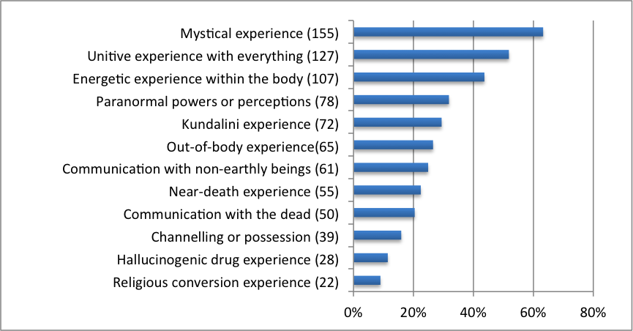
Descriptions of STEs

Slide 27
Other descriptions of STE
revelation
awakening
cosmic consciousness
spiritual revelation
indescribable peace
suspension of fear
healing experience
complete inner silence
visionary experience
paranormal powers
automatic writing
automatic body movements
telepathy
animal & plant telepathy
bi-location
precognition
communication
met my dead family member
communication with universe
mystical experience
pre-conception memories
past life experience
shamanic initiation
psychic rebirth
Synchronicity
Self-realization
Lucid dreaming
Prolongued transformation

Slide 28
Duration of STEs

Slide 29
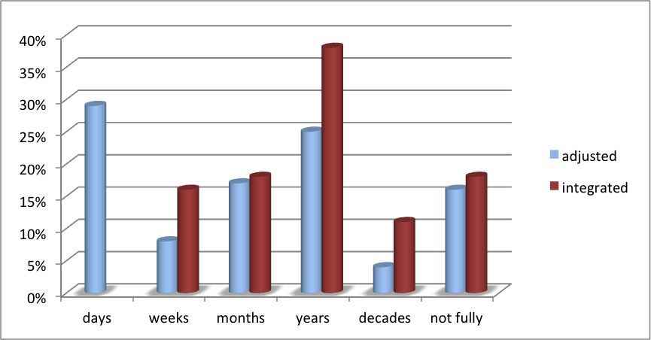
length of time for societal adjustment and psycho-spiritual integration

Slide 30
Inventory Analysis

Slide 31
ISTEI
Integration of
Spiritually Transformative Experiences Inventory
84 practices, habits, and behaviors that assist with integrating STEs

Slide 32
ISTEI Likert Scale
0. I did not try this practice
1. This practice was not at all helpful for integrating my STE
2. This practice was somewhat helpful for integrating my STE
3. This practice was very helpful for integrating my STE
4. This practice was essential for integrating my STE
5. I wish I had the opportunity to try this. It would have been very helpful.

Slide 33
Comparison Analysis of two scales within one inventory
1. Frequency that a practice was used.
2. Rated helpfulness of practice

Slide 34
Correlational Analysis What is the relationship of how helpful a practice is to how commonly it is used?

Slide 35
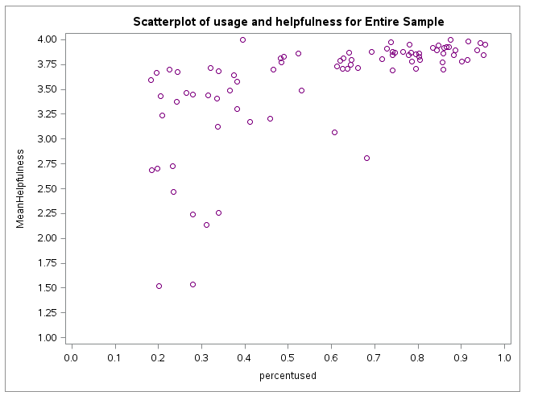
Correlation of Usage and Helpfulness

Slide 36
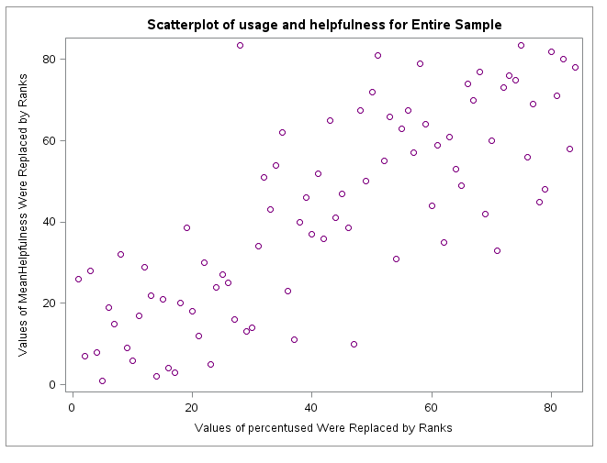
Spearmans Correlation is 0.772 p<0.0001

Slide 37
Viewing Rated Helpfulness Data in Eight Groups

Slide 38
84 practices, habits, and behaviors assigned to 8 groups
Social Situations – 13 items
Supportive Environments – 6 items
3. Supportive Activities – 14 items
4. Spiritual Practices – 9 items
5. Self-exploration– 19 items
6. Seeking professional clinical help – 7 items
7. Adjusting to heightened sensitivities – 8 items
8. Healthier Nutrition Habits – 8 items

Slide 39
Likert Scale for Helpfulness
4.0 essential
3.9-3.5 very helpful
3.5-3.0 very helpful
2.9-2.0 somewhat helpful
1.9-1.5 least helpful
1.0 not helpful

Slide 40
1. Social Situations
3.9 Chose the right people for sharing
3.8 Found non-judgmental listeners
3.8 Shared with a friend
3.8 Found ways to serve others
3.8 Found others who experienced similar things
3.8 Developed healthy relationships
3.8 Safe place to share
3.7 Found validation and assurance I was not psychotic
3.3 Endure responses when sharing
3.2 Accept how people responded
3.1 Remained active in society
2.7 Shared with family member
2.5 Workplace that offered support

Slide 41
2. Supportive environments
4.0 Calm environments
3.9 Serene time alone
3.9 Time in nature
3.9 Time with relaxed people
3.9 Calm interactions with people
3.7 Time in natural light

Slide 42
3. Supportive activities
3.9 Minimize stress
3.9 Relaxation
3.8 Light pleasant exercise such as walking
3.8 Minimize busy-ness
3.8 Simple focused calming activities
3.7 Regular communication with loved one or trusted friend
3.7 Rest
3.6 Self-massage or bathing/showering
3.5 Sleep
3.5 Moderated sexuality to fluctuating libido
3.4 Regular exercise
3.3 Regular sleep cycles
3.2 Light manual work such as gardening or housekeeping
2.2 Less time concentrating or reading

Slide 43
4. Spiritual Practices
4.0 Studied spiritual transformation
3.9 Daily prayer
3.9 Surrender to the divine
3.9 Read spiritual literature
3.8 Daily meditation
3.7 Supportive spiritual community
3.6 Visualized grounding my energy field to earth
3.5 Visualized centering and dropping inside
2.8 Lessoned rigor of spiritual practice

Slide 44
5. Self-Exploration
4.0 Practiced compassion
4.0 Allowed psychological issues to surface
4.0 Expressed myself through other creative practice
4.0 Practiced forgiveness
4.0 Practiced humility
4.0 Revised my purpose in life
4.0 Practiced honesty
4.0 Practiced gratitude
3.9 Got in touch with my feelings
3.9 Got in touch with my thought patterns
3.9 Shifted my sense of reality
3.9 Accepted responsibility for desiring this spiritual experience
3.9 Matched spiritual desires with earthly expectation
3.9 Accepted returning from expanded state to earthly realm
3.8 Expressed my inner experience through writing
3.8 Expressed my inner experience through verbal sharing
3.8 Explored my unconscious “dark side”
3.8 Expressed my inner experience through movement
3.6 Expressed my inner experience through drawing or painting

Slide 45
6. Seeking Professional Clinical Help
3.8 Considered or sought alternative health practitioner
3.8 Chose not to take prescription medicine
3.7 Received massages
3.2 Sought psychotherapy or counseling
2.1 Considered or sought psychiatric help
1.5 Considered taking prescription medicine
1.3 Chose to take prescription medicine

Slide 46
7. Adjusting to Heightened Sensitivities
4.0 Awareness of metaphysical events
4.0 Awareness of inner sensations
3.9 Sensitivity to others’ suffering
3.9 Sensitivity to light, sound, smell, taste, touch
3.8 Awareness of others’ thoughts/feelings
3.8 Sensitivity to toxic chemicals
3.6 Sensitivity to electromagnetic fields
3.4 Ability to predict the future

Slide 47
8. Healthier Nutrition Habits
3.8 Minimized junk foods
3.8 No more recreational drugs
3.7 No more alcohol
3.5 No more sugar
3.4 Scheduled regular meals
2.9 No more caffeine
2.7 Avoided fasting
2.4 More heavy foods such as meats, proteins, carbohydrates

Slide 48
Analysis of Rated Helpfulness data

Slide 49
Pair-wise comparisons between Group 6P (psychiatric care and medication) and other thematic groups

Slide 50
Research Findings
4 findings of strong statistical significance

Slide 51
Research assumption was correct:
Various of types of STEs have basic commonalities in methods of integration
(p<.0001)

Slide 52
Correspondence of Use to Helpfulness:
People undergoing spiritual emergencies can be trusted to know best what they need (p<.0001)

Slide 53
Essential practices:
Practiced compassion, forgiveness, humility, honesty, gratitude
Calmer environment near nature
Prayer and surrender to the divine
Allow the unconscious to surface
Creative expression
Share with one trusted person
Adjust to sensitivities
Creatively live a revised purpose in life
(rated 4.0)

Slide 54
Regarding psychiatric treatment:
Be cautious with psychiatry
Medication may be unnecessary or contraindicated
(p<.001)

Slide 55
My gratitude . . .
Spiritual Crisis Network (SEN)
Mike Rush, research group
Spiritual Emergence Anonymous (SEA)
Continued group support & inspiration

Slide 56
And . . .My gratitude to you, the audience, for
Showing up here
Enduring the boring part
Forgiving me any oversights
And acting interested!

